Slide 1

AIZONLABS
www.aizonlabs.com

Slide 2
Site Map
Home
About
Services
Team
Goal
Contact
Toggle Button

Slide 3
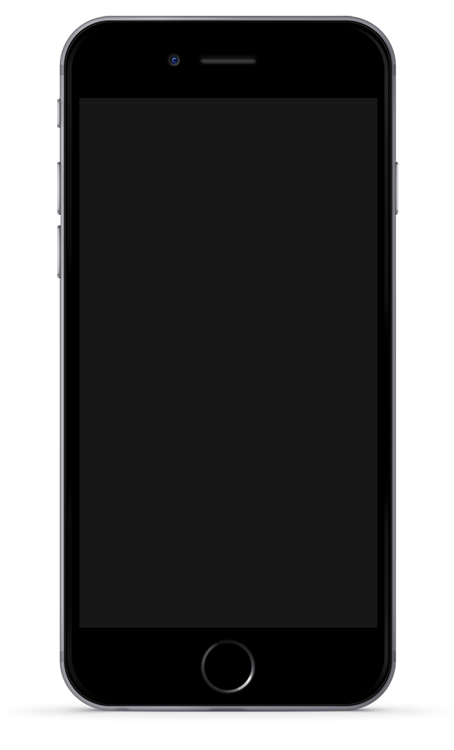
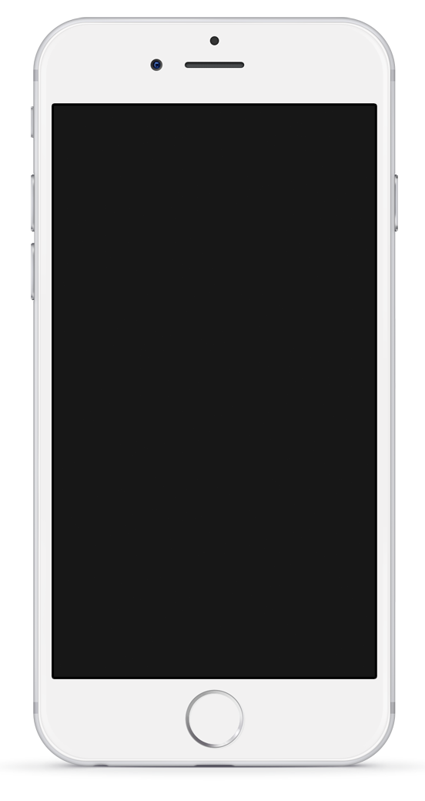
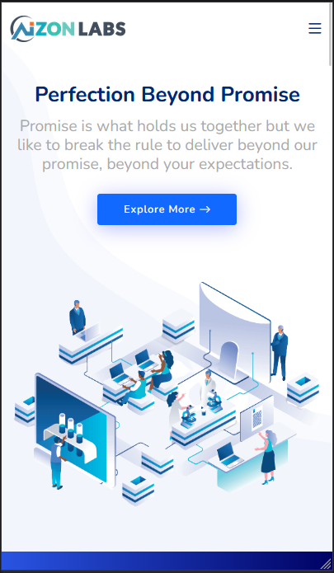
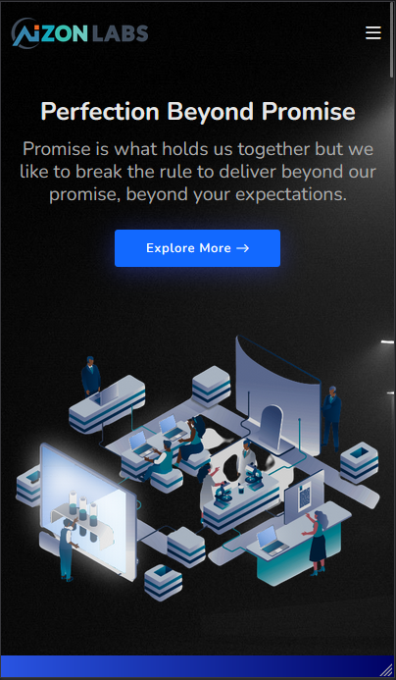
Design Concept
Responsive Web Pages
Concept:
Responsive
Work Description:
Responsive Bootstrap web page with Dark and Light mode. Aizon Labs web page is preferred to be a perfect responsive web page.

Slide 4
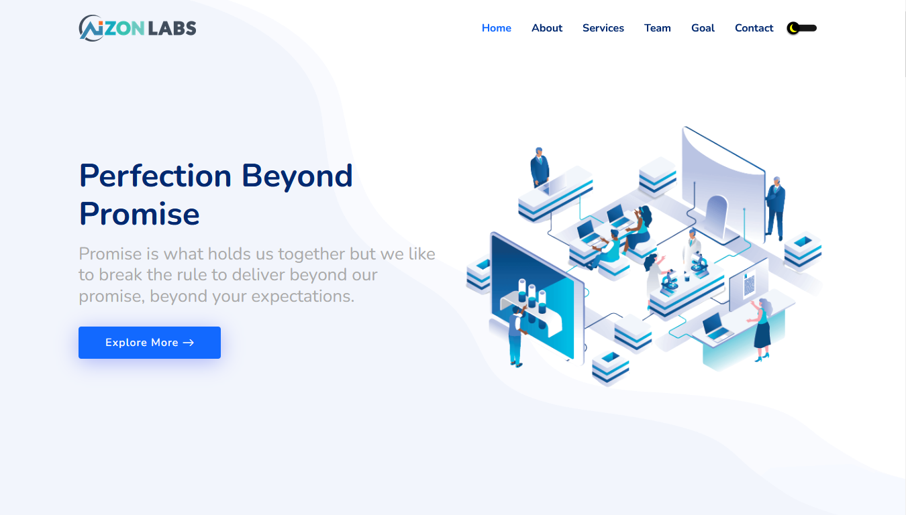
Design Concept
Light Mode Web Design
Concept:
Light mode

Slide 5
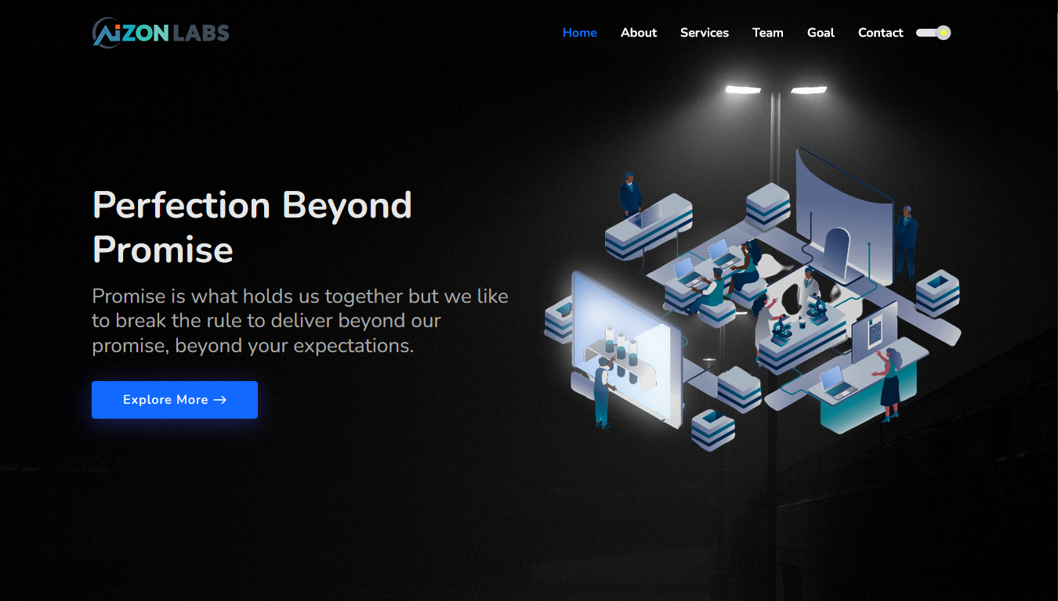
Design Concept
Dark Mode Web Design
Concept:
Dark mode

Slide 6
Design Concept
Responsive menu
Home
Logo on header
About
Home Page
Services
About the team
Team
Services & teams
Goal
Contacts &Footer
Contact
Toggle Button
Home screen
Menu screen

Slide 7
Wireframes
main menu
EXPLORE MORE
About the company
Team

Slide 8
Wireframes
main menu
EXPLORE MORE
About the company
Lap / desktop frame

